Slide 1
A Reconfigurable Multiple-Precision Floating-Point Dot Product Unit for High-Performance Computing

Slide 2
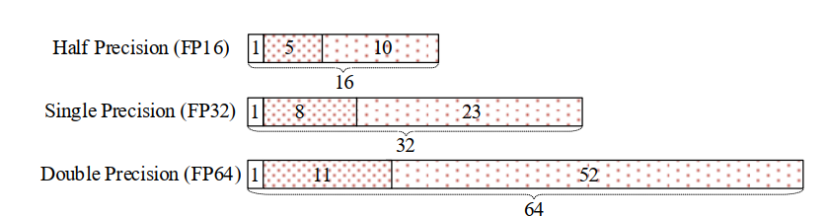
Floating-point (FP) numbers:
floating-point (FP) numbers:
16-bit half precision (FP16)
32-bit single precision (FP32)
64-bit double precision (FP64)
Goal: a reconfigurable dot product unit (DPU) for multiple-precision operations

Slide 3
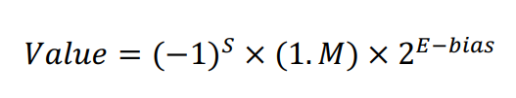
Floating-point (FP) numbers:
FP numbers: sign (S), exponent (E) and mantissa (M)
The significant digit number: 11(FP16), 24(FP32) and 53(FP64)
The bias: 15 (FP16), 127 (FP32) and 1023(FP64)

Slide 4
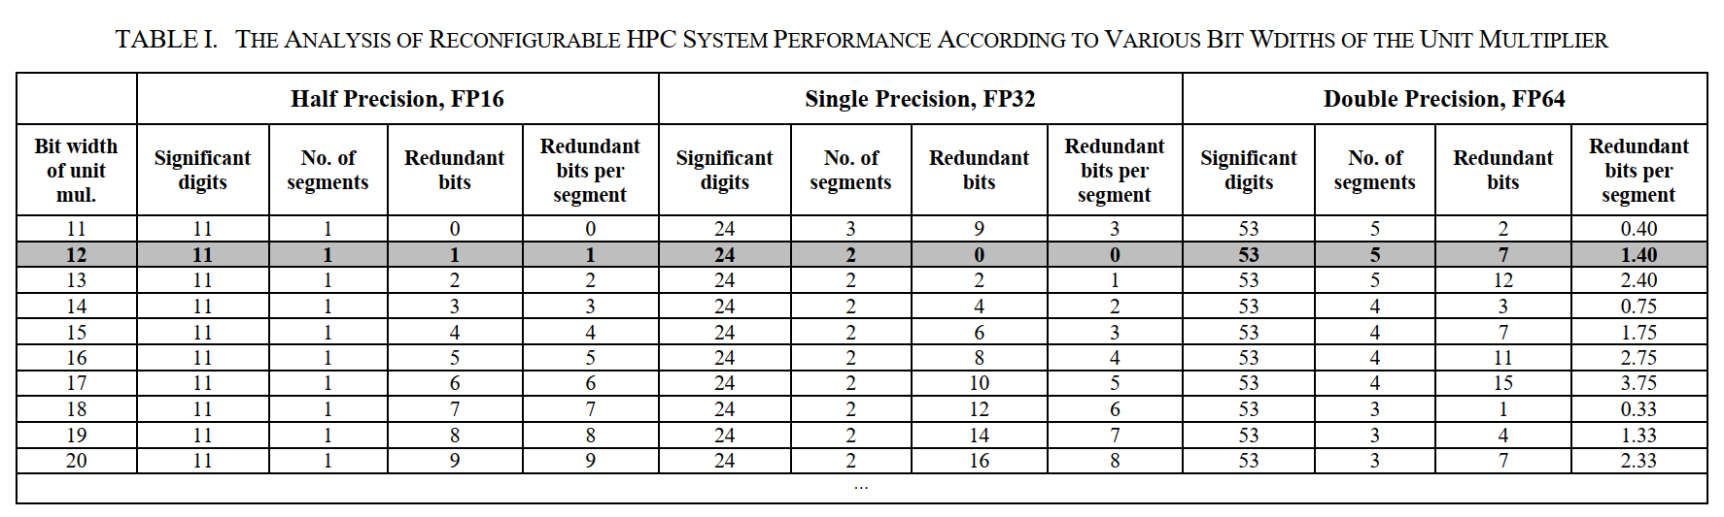
Bit-partitioning
the high-precision significant bits -> several subparts ->low-precision operation

Slide 5
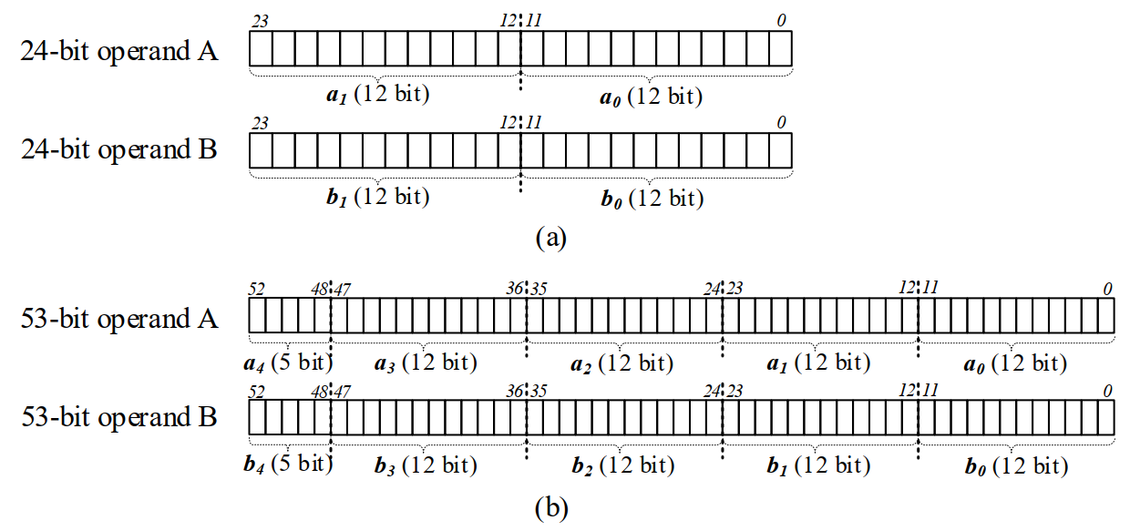
Bit-partitioning

Slide 6
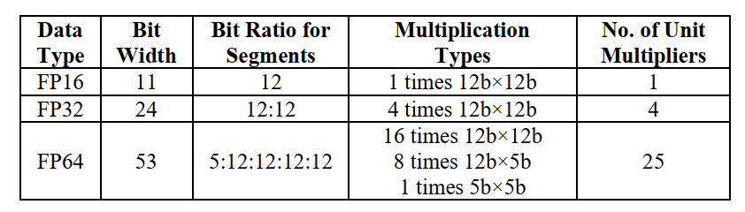


Bit-partitioning
FP32:
FP64:

Slide 7
Mixed-precision Fused Multiplier
16 12b×12b
8 12b×5b
1 5b×5b
The fused multiplier :12b×12b operation, two 12b×5b parallel operation, 12b×5b and 17b×5b parallel operation.
16 unit multipliers for 12b×12b operation, 4 fused multipliers for parallel 8 12b×5b operation and 1 5b×5b operation.

Slide 8
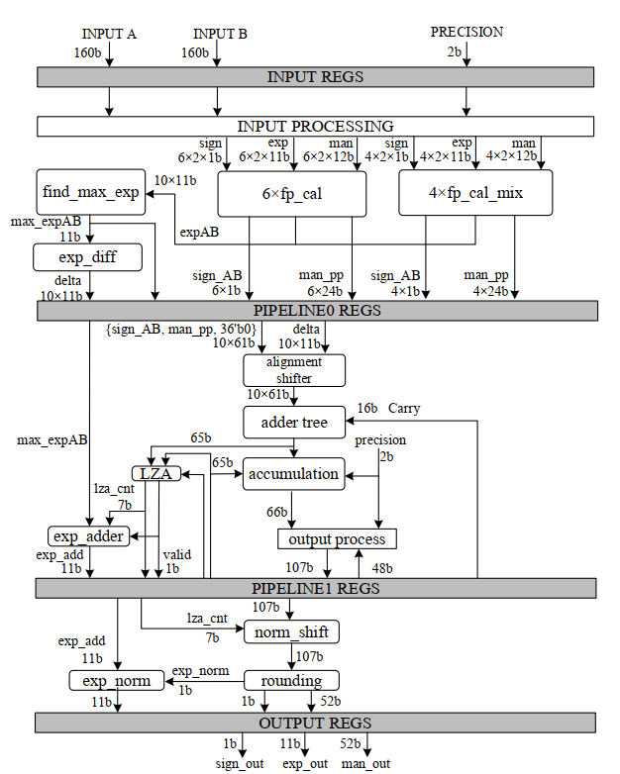

Slide 9
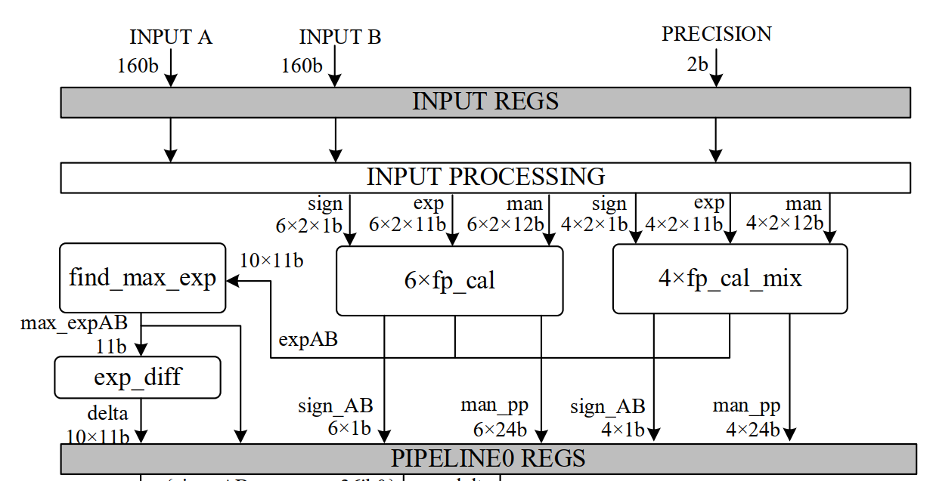
conventional
multipliers
mixed-precision fused multipliers

Slide 10
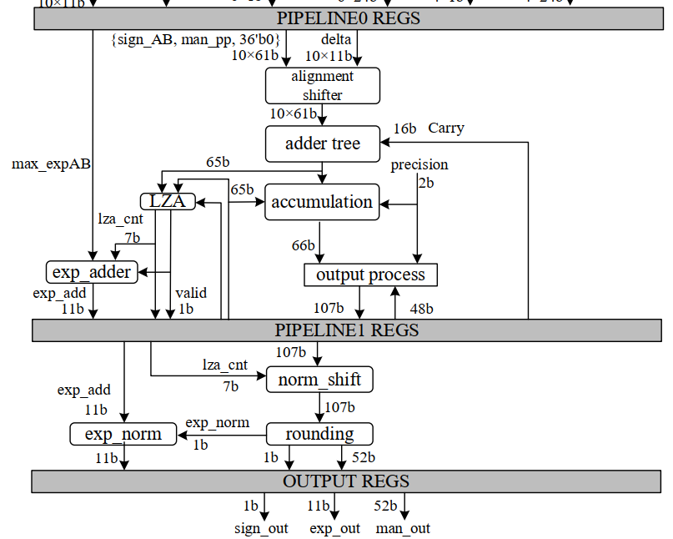
Leading-Zero Anticipator，LZA

Slide 11
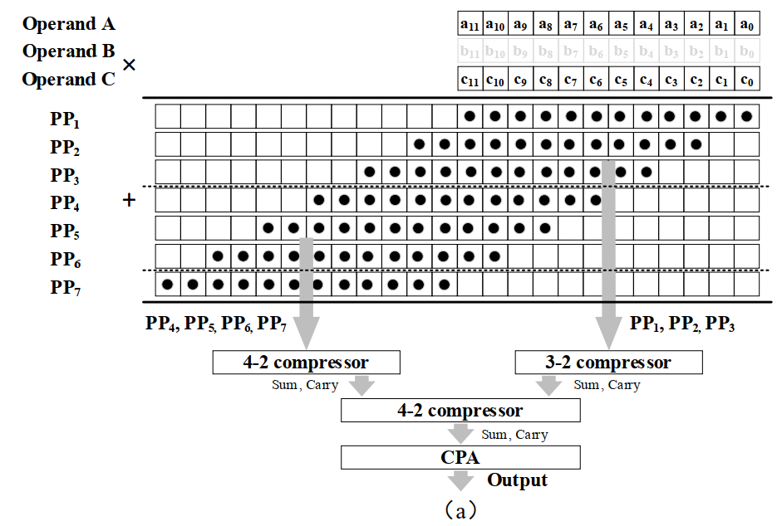
Mixed-precision Fused Multiplier
Radix-4 booth
12b×12b operations

Slide 12
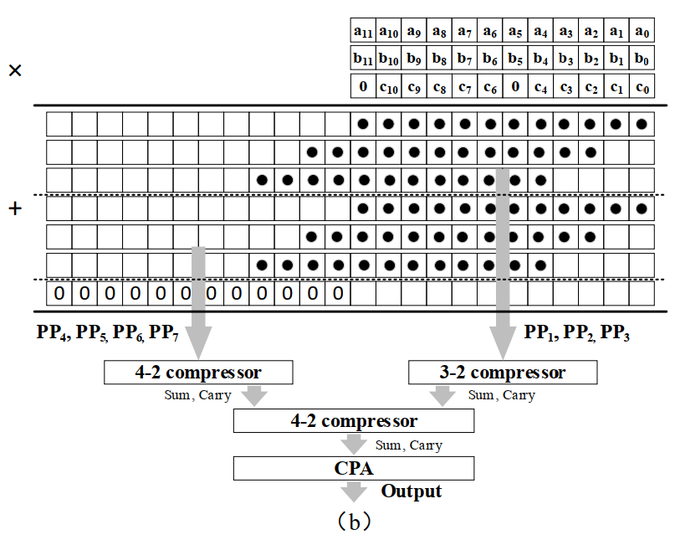
Mixed-precision Fused Multiplier
two 12b×5b operations

Slide 13
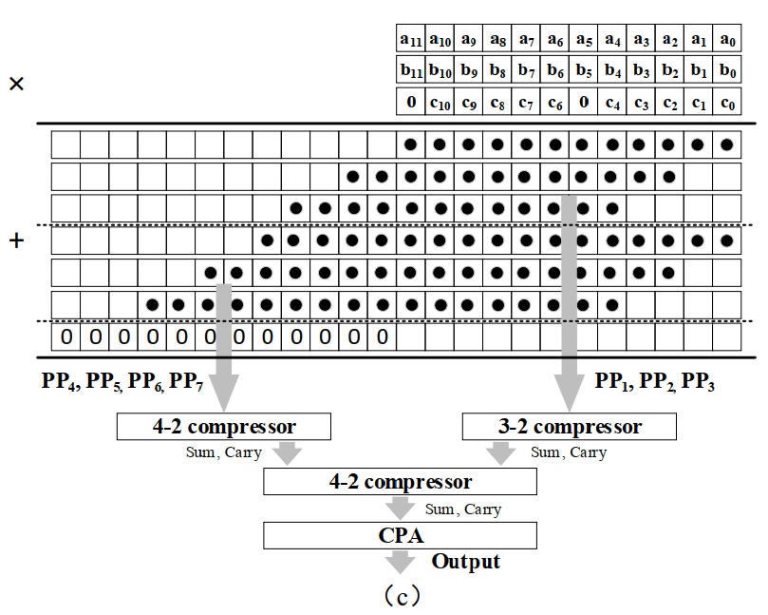
Mixed-precision Fused Multiplier
12b×5b and 17b×5b operations

Slide 14
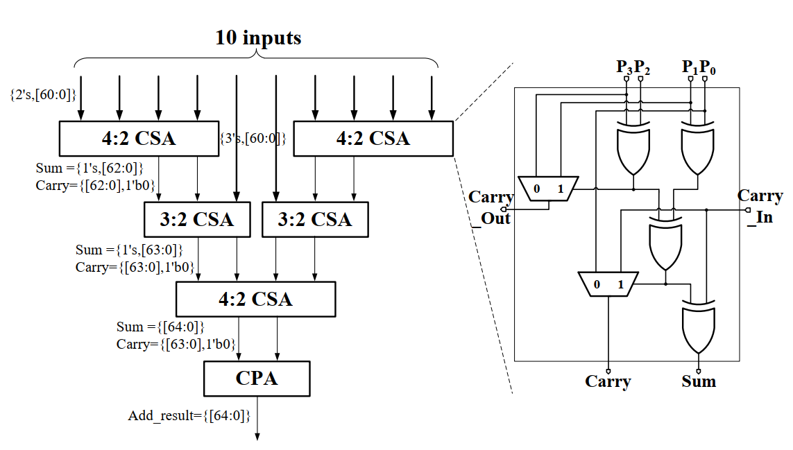
Reconfigurable Adder Tree

Slide 15
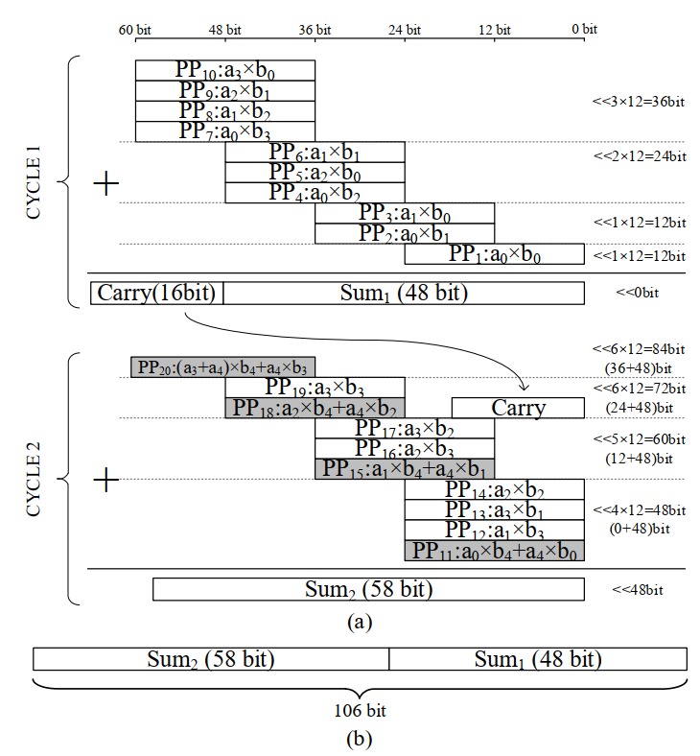
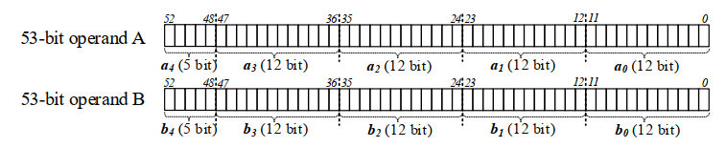
Reconfigurable Adder Tree
FP64:

Slide 16
Normalization and Rounding
LZA is used
lza_cnt is added to exp_max

Slide 17
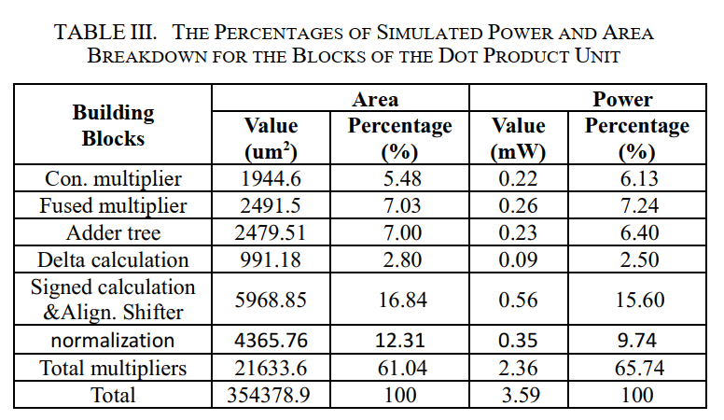
Experimental results
11.2% area and 7.3% power overheads
(compare with the proposed multiplier array with traditional multiplier array of 10 conventional unit multipliers)
The critical path is 3.52ns.

Slide 18
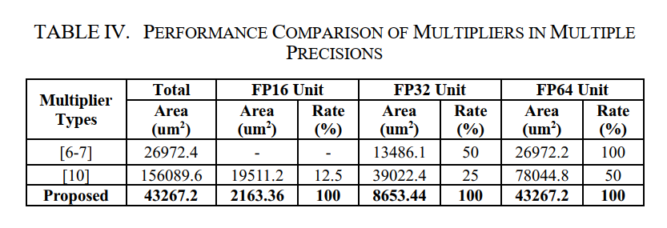
Experimental results
Smallest unit area for FP16 and FP32
Saves at least 88.9% and 35.8% when comparing with [6-7] and [10]
Also saves 44.6% area for FP64 when comparing with [10]
In addition, the utilization rates of the proposed work are 100% without gated idle hardware for all 3 precisions.

Slide 19
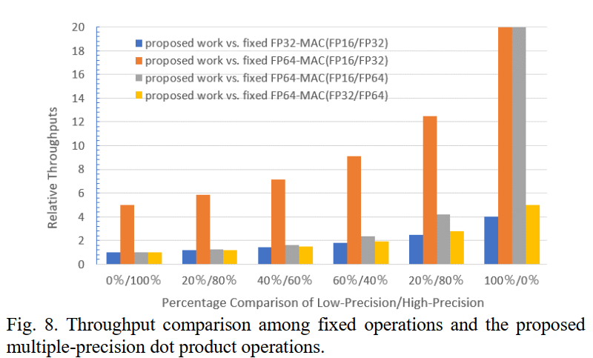
Experimental results

Slide 20
Main contributions
A reconfigurable FP DPU unit based on a novel bit-partitioning method with minimized redundant bits is proposed to support FP16, FP32 and FP64 precisions. •
For each precision, the unit multipliers of the reconfigurable system are all employed for operations without standby multipliers being gated.
The fused multiplier can support three mixed-precision multiplication operations. In addition, the operations can be executed in parallel.

Slide 21
THANKS!

Slide 22
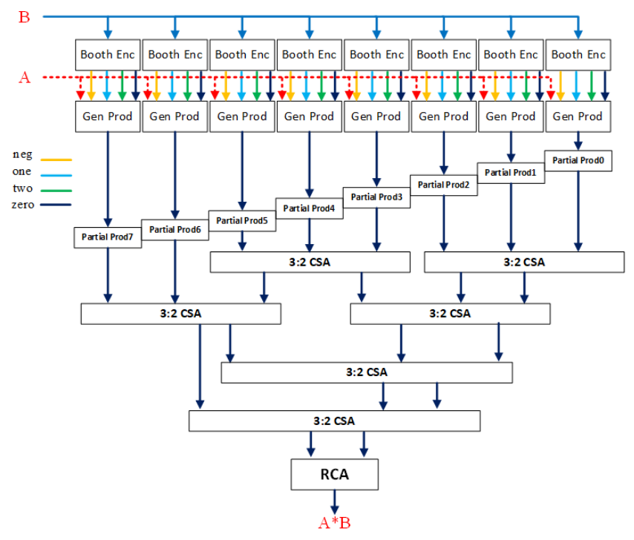
radix-4 booth

Slide 23
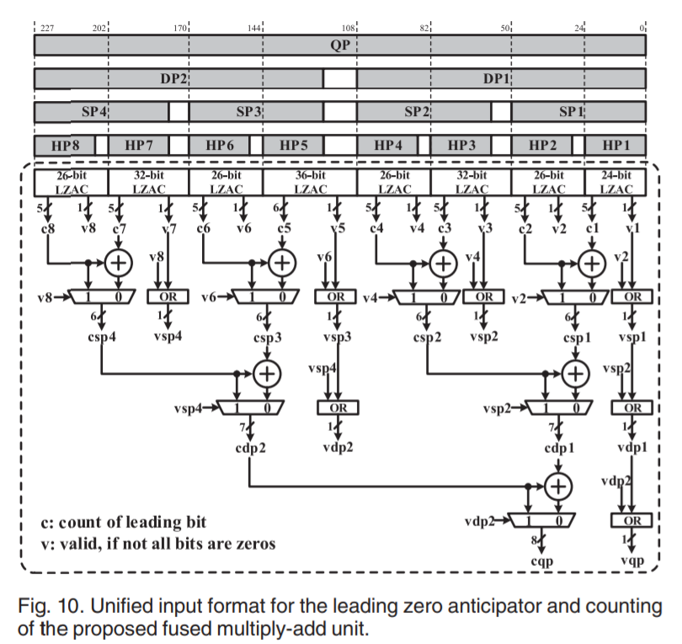
LZA

